Slide 1

City of Charleston-Homeless Resources
Presented by: Mariquetta Barnett
Community Liaison Homelessness Specialist

Slide 2
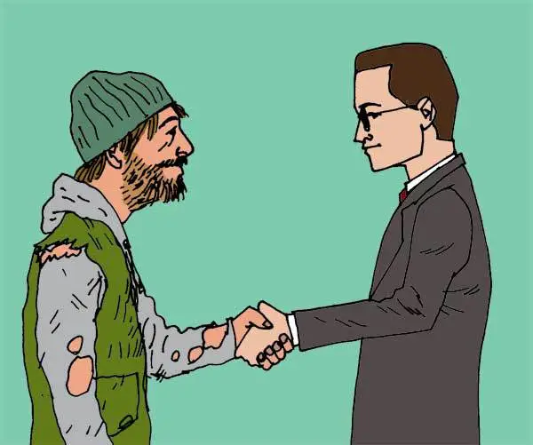
How to help our Unhoused Population
Facts about Unhoused individuals
  Vulnerable
  Afraid
  Hopeless
  Medical Crisis
  Max out of possibilities

Slide 3
Ways to help
Communication
Support
Provide resources
Be Positive

Slide 4
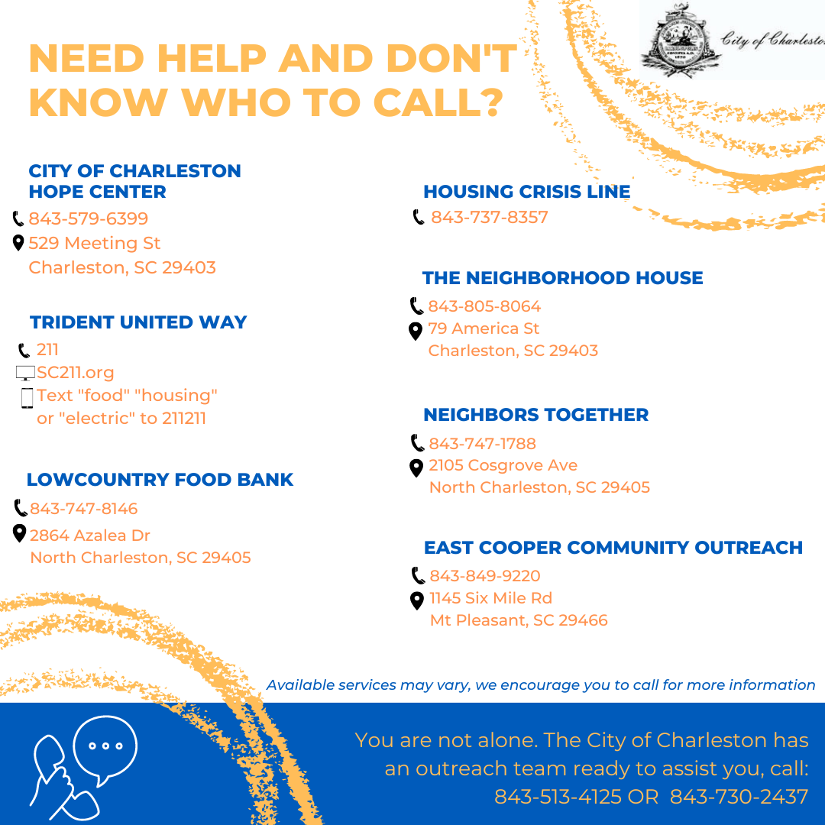
Resources
Have any questions please contact
Mariquetta Barnett 843-513-4125.

Slide 5

Thank you!!!
Housing Crisis Line
843-737-8357

