Slide 1
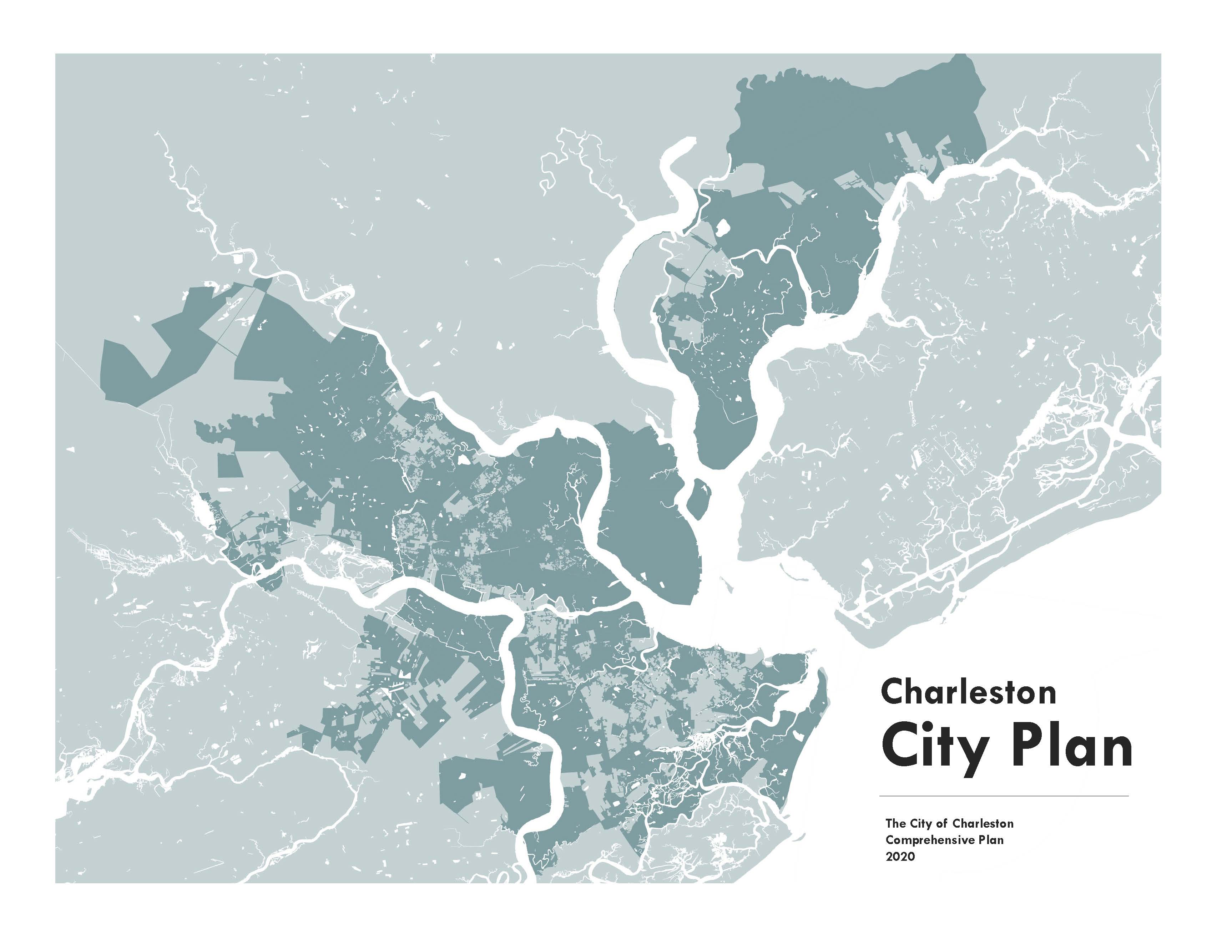

Slide 2
What is the comprehensive plan?
Required by the State of South Carolina in 1994 State
Comprehensive Planning Act (SC Code Title 6, Chapter 29)
Reviewed every 5 years, revised
every 10 years
Planning Commission develops the plan and recommends approval
City Council adopts the plan
Elements: population, economic development, natural resources, cultural resources, community facilities, housing, land use, transportation, priority investment, resilience
The ten elements of the plan are the Planning Commission’s
recommendations to the governing body

Slide 3
What the plan does...and doesn’t do
The plan:
Makes recommendations about the future
Uses objective information and analysis
Incorporates input from everyone
Informs daily decisions and recommendations by staff, Planning Commission and Council
The plan does not:
Change zoning, but future changes to zoning should be based on the plan’s recommendations
Change stormwater regulations
Change taxation
Make detailed policy recommendations already covered in other adopted plans

Slide 4
What we’re doing differently from Century V
Sea level rise and climate change are the first priority
Affordability and diversity prioritized
Objective analysis based on the best data available
Collaborative – a plan for and by the stakeholders

Slide 5
A collaborative effort
Role of Consultants:
Integrate the Dutch Dialogues recommendations
Analyze impacts of sea level rise and climate change
Analyze housing affordability and supply
Assist with meeting logistics and community engagement
Assist with graphic content and design of the plan document
Role of Staff:
Facilitate the process
Role of Community:
Assist with identifying needs and goals
Give input online and in public meetings

Slide 6
Partners in the plan
City Residents
Partner Governments
Property Owners
DOT, County, COG
Neighborhood Organizations
City Departments
Institutions & Employers
Community Organizations: Preservation, housing, flooding, business, arts and more

Slide 7
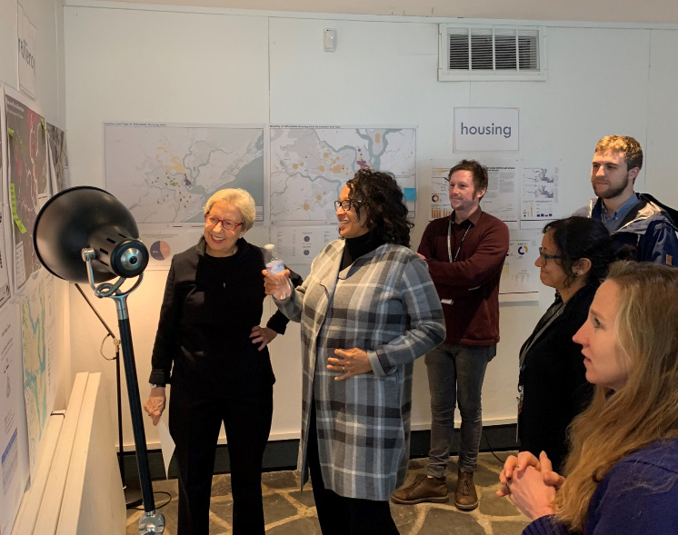
Staff preparation
Fall 2019 - Winter 2020
Best practices research
Logistics & outreach preparation
Bi-weekly data meetings
Compiling existing data
Cross-department collaboration

Slide 8
Timeline in brief
Task
Completion
Pre-Planning 2019 – Q2
Kickoffs Q1 – Q2
Learning Tour Q2 4.Civic Labs Q2
Drafting the plan Q3
Finalizing the plan Q4
Approval Q4 - 2021

Slide 9
Engagement Activities
Goals: accessible, varied and focused
Learning Tour
Meetings-in-a-box
Pop-up Stations
Online survey
Community Roundtables
Civic Labs
Presentations
Focus group labs with key community partners
Moderated Panel about reflections &
recommendations
April
Neighborhood Council Reception
Meeting-in-a-box Facilitator Training
May-June
Learning Tour
Civic Labs
July-September
Drafting the plan
October-November
Draft Plan Open House

Slide 10
Integrating Plan West Ashley
Plan West Ashley is a component of the current Comprehensive Plan
City Plan will build off of existing recommendations –
City Plan is not replacing or duplicating the focus of Plan West Ashley
Incorporating new data and analysis related to climate change and housing supply
WARC members will be encouraged to be community outreach to make sure the residents of West Ashley are heard
Opportunity to continue the objectives of Plan West Ashley as part of Future Land Use recommendations

Slide 11
Charleston
City Plan
The City of Charleston Comprehensive Plan 2020

