Slide 1
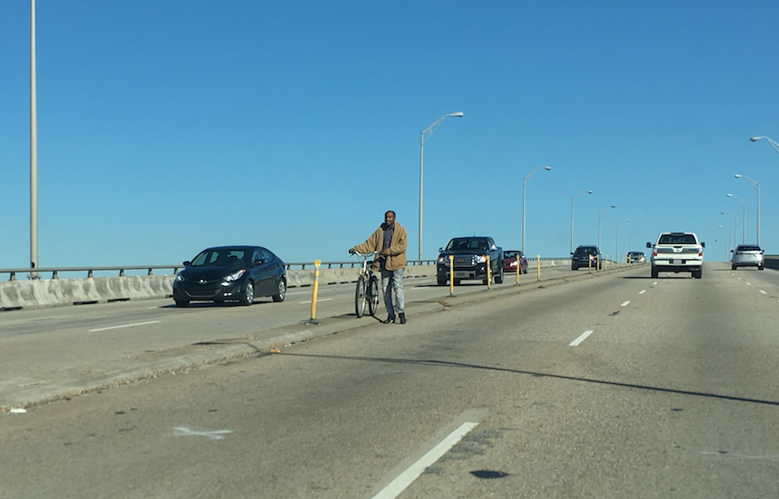
North Bridge: Safe Access
Photo: David Christopher
March 11, 2020

Slide 2
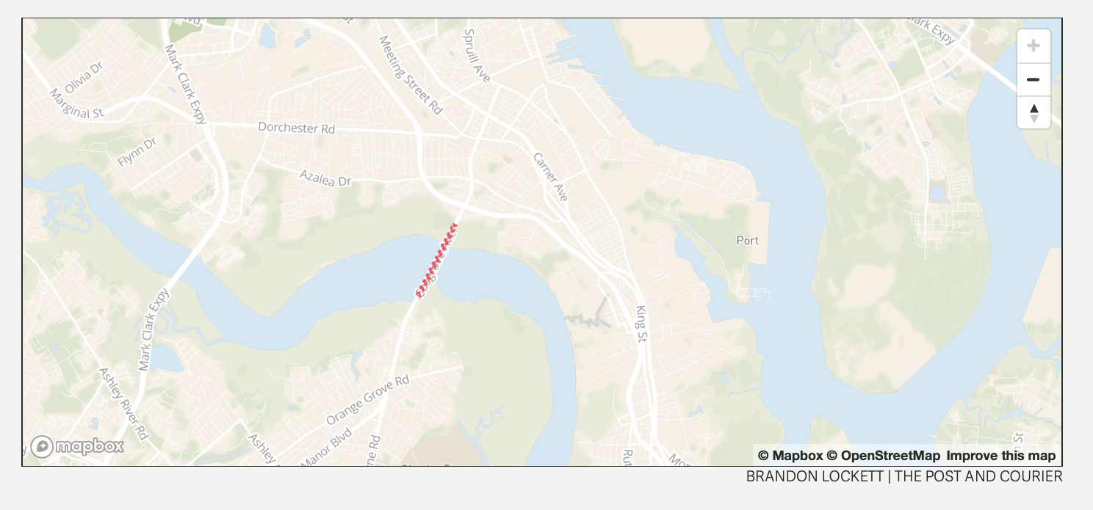
AADT Counts over Ashley River:
44,300 (2006)
46,100 (2016)
48,600 (2019)
Length: 0.52 mi. (Northbridge Park > 1st Exit), 1.5 mi. (Poston > Azalea)
Length Comparison: 0.84 mi. (ARB), 2.9 mi. (JIC)

Slide 3
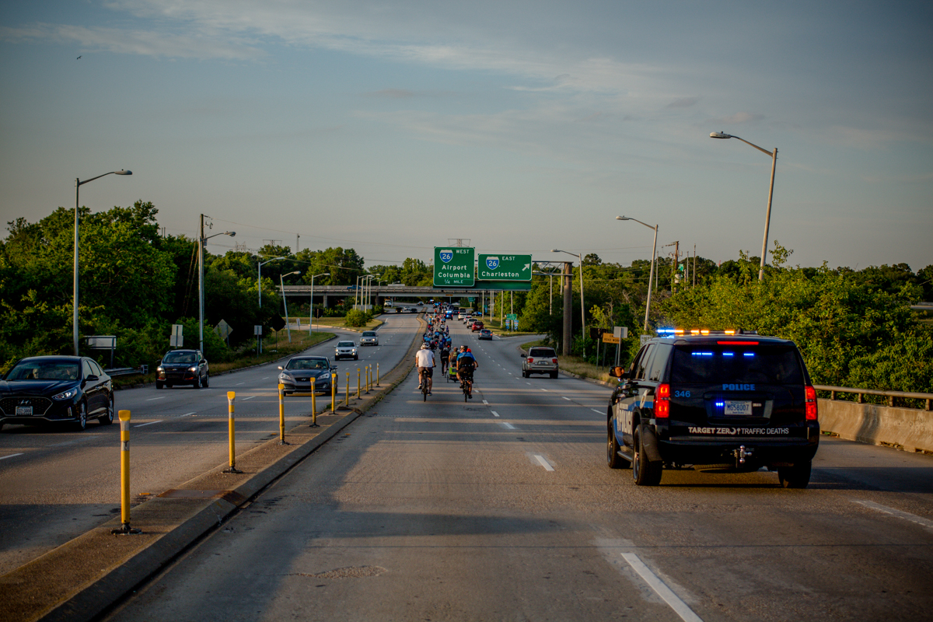
SCDOT: young bridge, not on any current replacement lists. Agency does not expect replacement unless a significant capacity improvement is proposed. Even then, replacement unlikely. Considered to be performing acceptably.
CARTA: Rte. 32 has a 1 hr. headway. Operates from approx. 6a-9p weekdays, 7a-9p Sat., 9a-8p Sun.
Photo: S E V E N

Slide 4
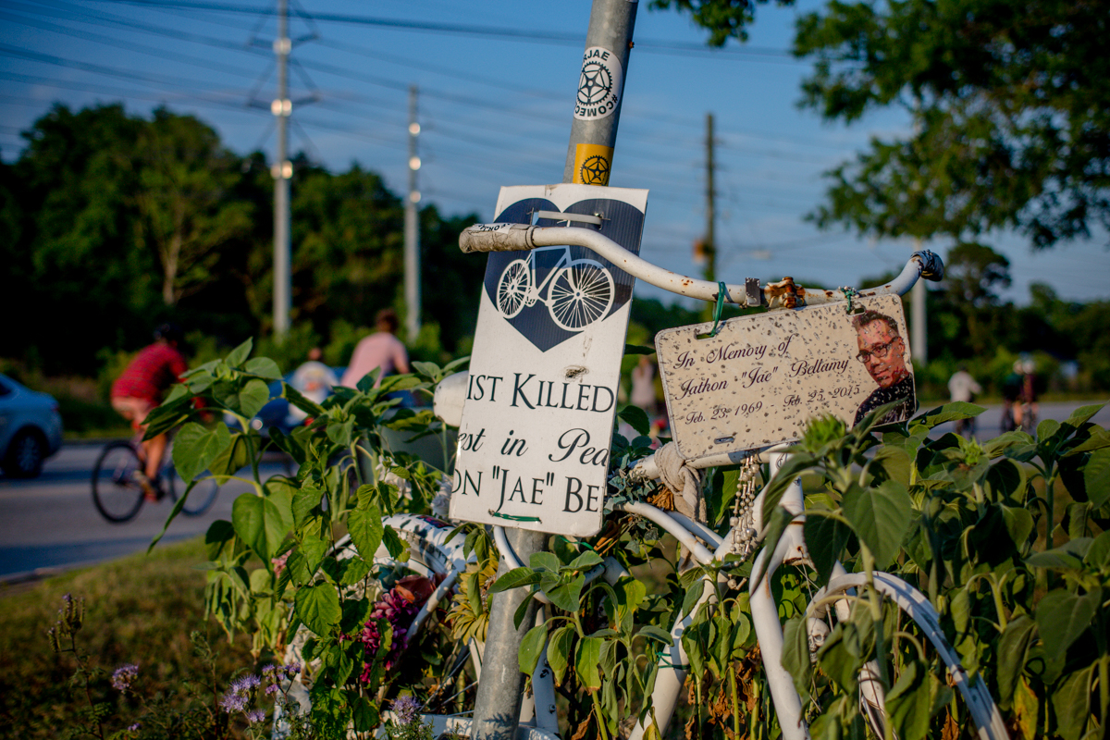
Safety Stats
2013-preliminary 2018
From Azalea Drive to Poston Road, including the North Bridge:
2 fatalities
8 injuries
Photo: S E V E N

Slide 5
Previous Studies:
Summary + Findings
“Not Feasible” in 2008:
Restripe ($4.9M)
Widen ($23.7M)
Combination Restripe + Median Removal ($2.6M)
Reversible Lane ($2.9M)
Notes: traffic projections didn’t match up to actuals, bike/ped counts subpar, didn’t study in depth what additions the bridge could handle, ROW impacts have changed, interchange modification potential not studied

Slide 6
Findings, cont.
Undetermined:
2008 mention of a catwalk addition. Stated required detailed structural analysis of existing components and 1950s pre-widening components. No cost estimate. Updated info: entity who adds to bridge assumes entire responsibility.
2011 alternative to eliminate a northbound lane. Stated some concerns but also stated that doing nothing still leaves a problem unaddressed.

Slide 7
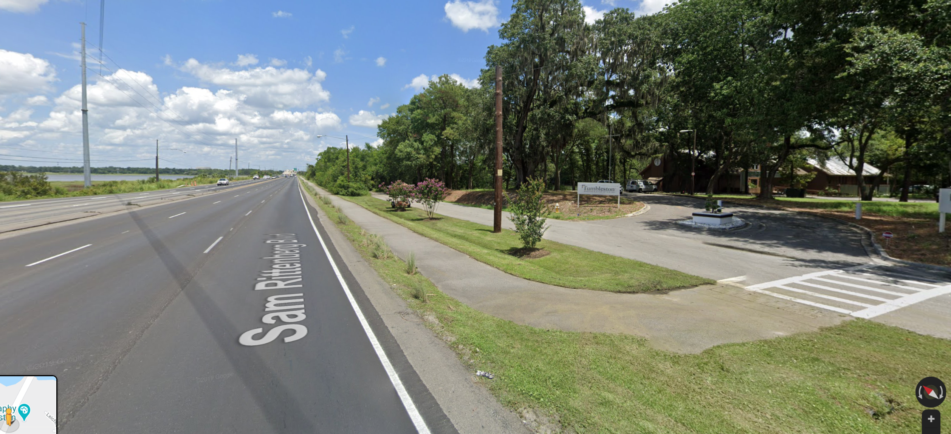
Findings, cont.
“Feasible” in 2008:
Combination of separate path land-side + separate bridge ($7.2M for bridge itself, land-side costs outdated because paths have since been installed on West Ashley side)
Proposed staging: install path from Poston to Southgate, let CARTA handle things while bike/ped standalone bridge funding is identified

Slide 8
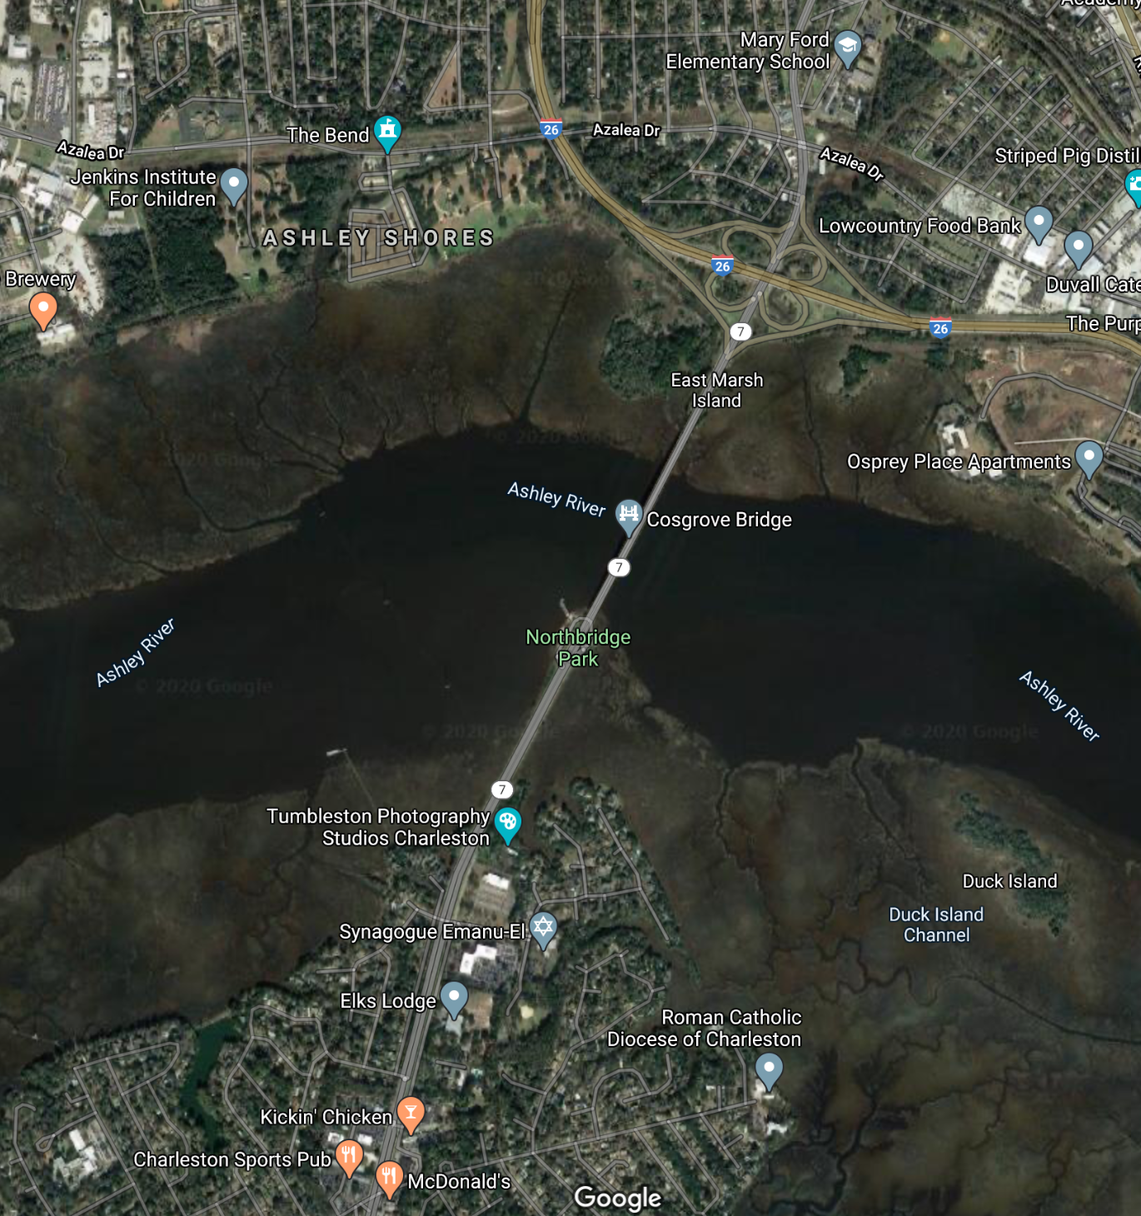

Slide 9
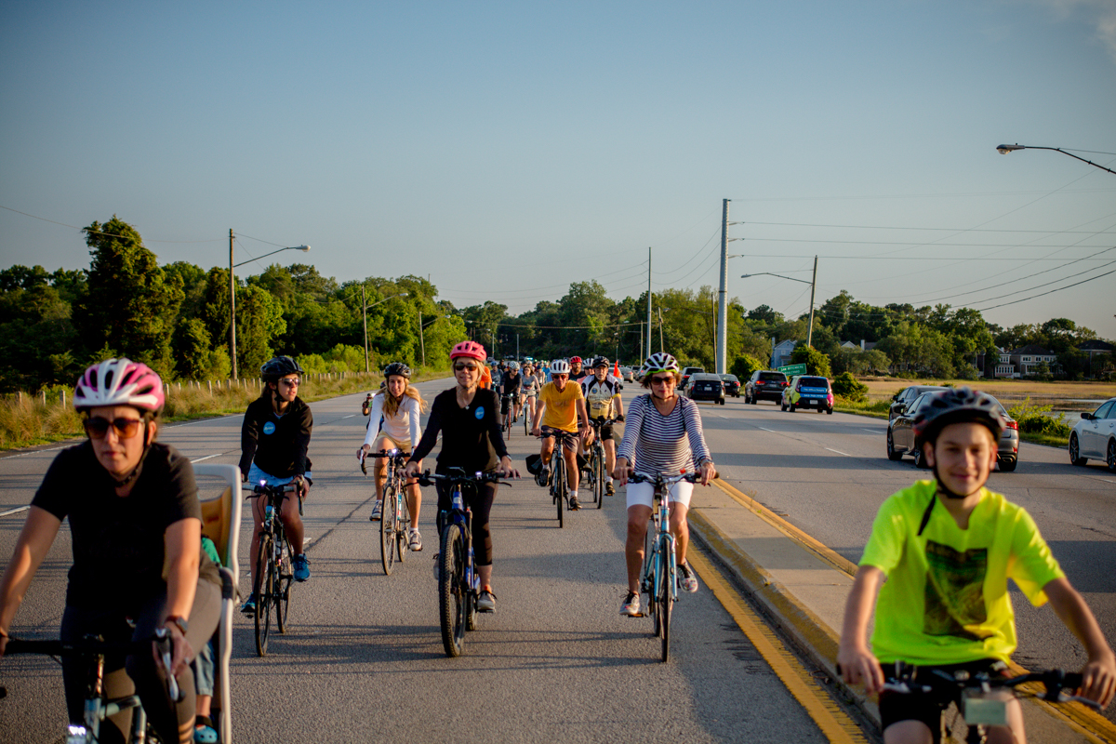
Community Support
~2,300 petition signatures
~200 Ride of Silence 2019
participants
Charleston Police Department
Lowcountry Food Bank
Metanoia
Reynolds Avenue Area Merchants
Association
The Bend + Susan Pearlstine Norton
West Ashley United
Photo: S E V E N

Slide 10
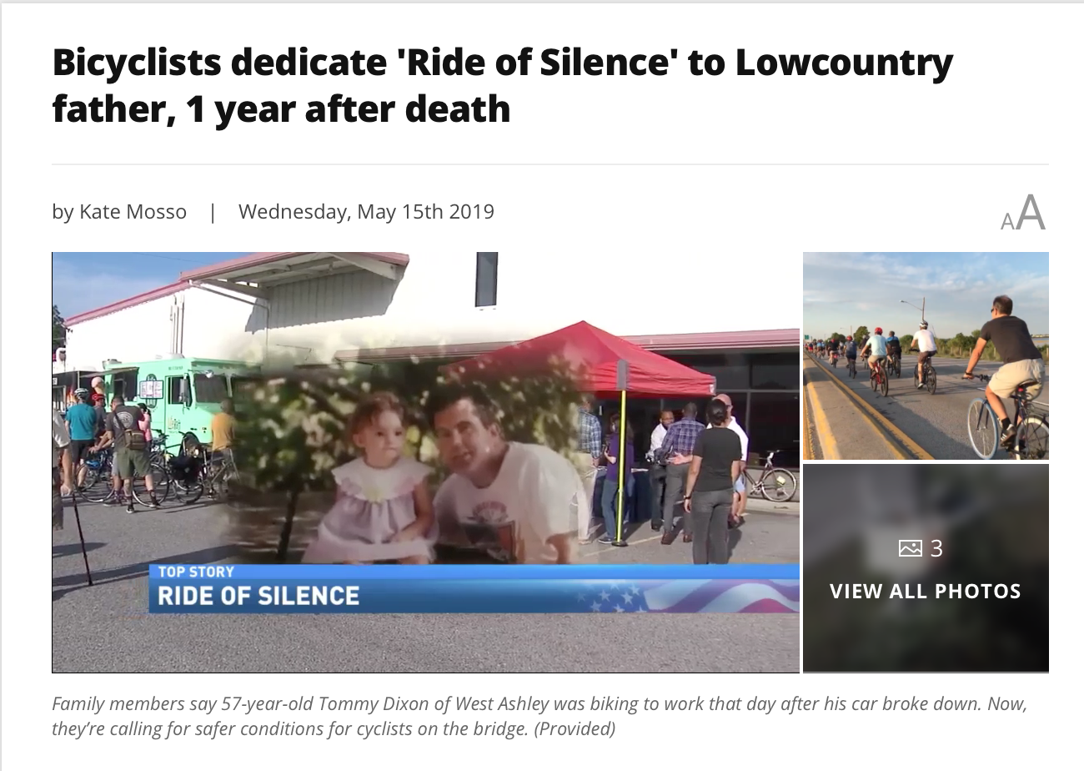
Regional Commitments
Plan West Ashley
People2Parks
Walk Bike Berkeley-Charleston-Dorchester Plan
Mayor Summey’s North Charleston 2020 State of the City Address:
“One life alone is bad enough to lose.”
Still: ABC News 4

Slide 11
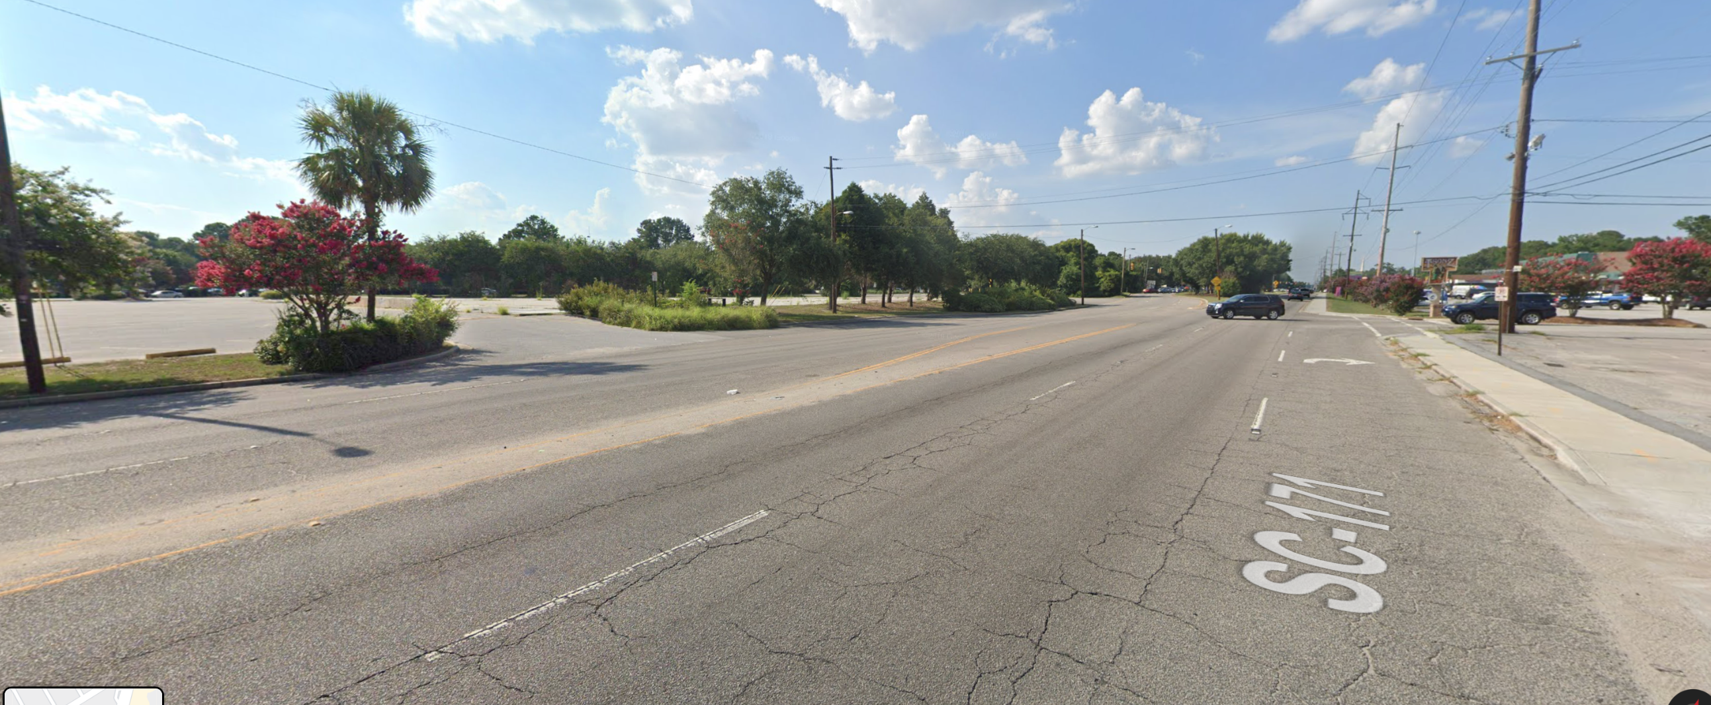
Connecting Projects
7 &171 study area — multimodal improvements
Azalea sidewalk improvements from Easton St. > Cosgrove Ave.

Slide 12
Updated Study Needs
Charleston Moves will be conducting bike/ped counts in Apr. + May 2020
What is the updated design and cost estimate for a separate bridge, now that some of the land-side options are in place?
Where would the entry and exit points be?
What are land-side improvements that can be made soon?

Slide 13
Assess infrastructure improvement opportunities for each side to connect to the bridge, and
Update study to focus on standalone bike/ped bridge

Slide 14

Thank you!

